Slide 1

Phase5 SW Release Plan
Roger Xu, Jiajia Zhou, James Chen
Date: March 3, 2021
Desired Outcome
Awareness
Decision
Escalation Help
Think
Point of view
Plan to Implement
Implement

Slide 2
Phase 5 Vehicles Timeline
2021 | 2022 | 2023
1 | 2 | 3 | 4 | 5 | 6 | 7 | 8 | 9 | 10 | 11 | 12 | 1 | 2 | 3 | 4 | 5 | 6 | 7 | 8 | 9 | 10 | 11 | 12 | 1 | 2 | 3 | 4 | 5 | 6 | 7 | 8 | 9 | 10 | 11 | 12
CDX707
UPV1
UPV2
PA
FDJ
DCV
PEC
TT
PP
MP1
FEC
05/28
01/19
02/19
06/30
08/06
05/30
07/26
10/11
02/01
07/11
CDX747
UPV0
UPV1
UPV2
PA
FDJ
DCV
PEC
FEC
TT
PP
MP1
MP2
OK2B
11/23
03/13
06/12
11/06
04/06
06/11
09/24
10/27
01/07
07/11
10/26
12/12
10/09
U611MCA
UPV0
UPV1
UPV2
PA
FDJ
DCV
PEC
FEC
HB
TT
PP
MP1
OK2B
11/04
02/28
06/13
03/16
06/11
10/17
12/13
06/13
10/07
09/05
12/06
01/23
09/24
CX788
FDJ
DCV
HB
TT
MP1
MP2
UPV0
UPV1
UPV2
PA
PEC
FEC
PP
OK2B
05/18
03/29
04/26
08/29
11/04
05/24
05/10
07/26
10/15
02/10
09/16
10/28
01/17
06/21
Phase5 Scope
Program | PMT5 | Nameplate | Manufacture | J1 | OKTB | EE Architecture | Centerstack Size | Cluster |  | TCU | ECG
CDX707 | Yang Youfei, Xu Fiona | Nautilus | CAF | 3/28/2023 | 3/28/2023 | FNV3 | 23.6(Pano-Non touch)*2&11.1(Controller-Touch) |  | Landscape | Boundle6 | ECG2
CX788 | He Sylvia | Ford | CAF | 4/26/2023 | 6/21/2023 | FNV2 | 13.2~15.5 TBD | NA, AR HUD | Landscape | Boundle5 | ECG2
CDX747 | Yang Frank | Lincoln | BU | 6/12/2023 | 11/6/2023 | FNV3 | 23.6(Pano-Non touch)*2&11.1(Controller-Touch) |  | Landscape | Boundle6 | ECG2
U611 MCA | Yang Frank | Aviator | CAF | 12/6/2023 | 1/23/2024 | FNV3 | 27 | 12.3，Standalone HUD | Landscape | Boundle6 | ECG2
U718 | Yang Frank | Navigator | BU | 3/11/2024 | 4/22/2024 | FNV3 | 23.6(Pano-Non touch)*2&11.1(Controller-Touch) |  | Landscape | Boundle6 | ECG2
CDX804 | Johnny | Lincoln | IMF | TBD | TBD | TBD | TBD |  | TBD

Slide 3
CDX707 SW Release Plan
2021 | 2022 | 2023
1 | 2 | 3 | 4 | 5 | 6 | 7 | 8 | 9 | 10 | 11 | 12 | 1 | 2 | 3 | 4 | 5 | 6 | 7 | 8 | 9 | 10 | 11 | 12 | 1 | 2 | 3 | 4 | 5 | 6 | 7 | 8 | 9 | 10 | 11 | 12
CDX707 VPP
UPV2
UPV1
PA
FDJ
DCV
PEC
FEC
TT
PP
MP1
MP2
OKTB
02/19
05/28
06/11
06/30
07/14
08/06
08/20
01/19
02/02
05/30
06/13
07/11
07/25
07/26
08/02
10/11
10/18
03/28
03/01
CDC AHU HW
02/01
07/10-08/20
10/25-12/15
05/15-06/15
Pre-DV
B0 DV1
10/05
DV1
DV2
A0 PCBA
01/07 01/25
A1 PCBA
04/30
A2 Pre-DV
06/30
B1 DV2
04/15
Display(23.6+23.6,11.1 touch)
09/30-10/30
12/05-12/11
23.6 Pre-DV
03/22-06/09
11.1 EMC
23.6 DV
GPDS SW Version for MRD
DCV Beta
07/20
DCV2
01/05
R04
05/30
SW Release for REC
DCV0
10/27
DCV1
11/24
DCV3
02/16
R00
04/18
R05
07/06
R06
09/21
R07 12/06
Spring Festival
National Day
Spring Festival
National Day
Spring Festival
R15
05/18
R16
06/15
R17
07/13
R19
09/07
R20
10/19
R21
11/20
R22 for OKTB
01/15
R1
03/31
R4
06/23
R5
07/10，07/18
R10
12/15
R11
01/12
R12
02/23
R13
03/23
R14
04/20
R18
08/10
R0
03/19
R2
04/28
R3
05/26
R6
08/18
R7
09/15
R8
10/20
R9
11/17
Package 1-HW+Base SW
R15
04/20
R20
09/07
R21
10/19
R22 for OKTB
12/15
R0
02/23
R1
03/03
R2
03/31
R3
04/28
R4
05/26
R5
06/20
R6
07/21
R7
08/18
R8
09/15
R9
10/20
R10
11/17
R11
12/15
R12
01/12
R13
02/23
R14
03/23
R16
05/18
R17
06/15
R18
07/13
R19
08/10
Package 2-Ford core service
R15
04/20
R20
09/07
R21
10/19
R22 for OKTB
12/15
R0
02/23
R1
03/03
R2
03/31
R3
04/28
R4
05/26
R5
06/20
R6
07/21
R7
08/18
R8
09/15
R9
10/20
R10
11/17
R11
12/15
R12
01/12
R13
02/23
R14
03/23
R16
05/18
R17
06/15
R18
07/13
R19
08/10
Package 3-Eco APPs
R15
04/20
R20
09/07
R21
10/19
R22 for OKTB
12/15
Eng version for vendor’s internal release and test.
R0
02/23
R1
03/03
R2
03/31
R3
04/28
R4
05/26
R5
06/20
R6
07/21
R7
08/18
R8
09/15
R9
10/20
R10
11/17
R11
12/15
R12
01/12
R13
02/23
R14
03/23
R16
05/18
R17
06/15
R18
07/13
R19
08/10
Inhouse APPs
Eng version not necessary to release.
R15
04/20
R20
09/07
R21
10/19
R22 for OKTB
12/15
Pro version released for REC, focus and lite test.
R0
02/23
R1
03/03
R2
03/31
R3
04/28
R4
05/26
R5
06/20
R6
07/21
R7
08/18
R8
09/15
R9
10/20
R10
11/17
R11
12/15
R12
01/12
R13
02/23
R14
03/23
R16
05/18
R17
06/15
R18
07/13
R19
08/10
Package 4-HMI
Pro version released for REC, full test.
Group A for DCV Beta(R0-R5)
12/15 Delayed to 03/15 UE,04/30 UI
Cluster Assets 03/05
Group B for DCV1(R6-R9)
06/15
Group C for DCV3(R10-R11)
07/30
Group D for DCV2(R12-R13)
08/31

Slide 4
CX788 SYNC+/AR-HUD/Display Draft Plan A@03/03
2021 | 2022 | 2023
1 | 2 | 3 | 4 | 5 | 6 | 7 | 8 | 9 | 10 | 11 | 12 | 1 | 2 | 3 | 4 | 5 | 6 | 7 | 8 | 9 | 10 | 11 | 12 | 1 | 2 | 3 | 4 | 5 | 6 | 7 | 8 | 9 | 10 | 11 | 12
CX788 VPP
UPV0
UPV1
UPV2
PA
FDJ
DCV
PEC
PP
MP2
OKTB
FEC
TT
MP1
05/31
08/16
12/08
01/07
10/14
11/08
06/13
03/14
05/03
06/28
New Display
3/1-5/31
06/01-11/30
12/01-03/15
04/16-07/15
07/16-10/15
11/23
12/29
05/31
03/16-05/15
EC Approval
Tooling 6 months
DV 3.5 months
Re-DV
PV 3 months
PPAP 3 months
09/15
01/31
08/04
02/28
No ME Change Post PoC
UPV0
11/15
03/01
09/15
11/01
TT
UPV1
UPV2
FDJ
DCV
PEC
FEC
AR-HUD-Plan A
SW Sign Off
AR ADAS Related Feature
3/1-4/31
12/15-06/15
06/16-09/15
09/16-10/31
11/01-01/31
02/01-02/28
EC Approval
Tooling 6 months
DV 3 months
Re-DV
PV 3 months
PPAP
MP1 SW
04/15
POC Kick Off
03/01
POC Prototype Delivery
08/15
EMC
05/04-06/19
SW Sign Off
AR Navi, Traditional HUD Feature
11/20
MP2 SW
05/31
OTA Debug SW
TFT HUD
3/1-4/31
12/1-05/15
05/16-08/15
08/16-9/31
10/7-01/7
Risk/Enabler: To be updated.
1. HUD/Display:
1) Sourcing complete as request;
2) ME change after PoC and drive 2 wks late;
2. CDC HW:
1) Deliver parts to CAF after EMC complete;
2) Support proposed TT MRD w/ alert;
3. CDC SW:
1) Sourcing:
2) Discuss feasibility with supplier for HMI UI group A/B;
3) HMI stick on the plan for group C/D;
4) HMI confirm to protect groups release when reverting to option 2;
EC Approval
Tooling 5.5months
DV 3 months
Re-DV
PV 3 months
Substitute parts before CDC HW DV test:
Display: Support 2700*1080 resolution display ; - Forrest
AR-HUD substitute: Discuss with Baidu;- Forrest
EMC
04/10-05/15
CDC AHU HW
01/01-02/01
05/04-07/04
09/11-10/11
11/25-02/22
03/22-04/04
Pre-DV
B0 DV1
04/15
EMC/DV1
DV2
PV
PPAP
A2 Pre-DV
09/15
B1 DV2
09/04
GPDS SW Version for MRD
DCV Beta
01/07
DCV1
04/18
R05
11/08
R06
01/17
SW Release for REC
DCV0
03/21
DCV2
05/30
DCV3
07/11
R00
09/02
R04
10/12
R07 03/15
National Day
Spring Festival
Spring Festival
R15
11/15
R21
05/30 for OKTB
R4
11/25
R5
12/25
R10
05/30
R11
06/30
R14
09/30
R16
12/15
R17
01/15
R18
02/28
R19
03/30
R20
04/30
R7
02/30
R9
04/30
R12
07/30
R13
08/30
R8
03/30
Package 1-3-HW+Base SW
R4
10/25
R5
11/25
R8
02/28
R10
04/30
R11
05/30
R12
06/30
R13
07/30
R14
08/30
R15
10/15
R16
11/15
R17
12/15
R18
01/15
R19
02/28
R20
03/30
R21
04/30
R9
03/30
IVI/LED Strip/HUD UI Plan
Group B UI
11/15
Group A UI Release
Group A UE
06/31
Group A UI
10/15
Group C UI
12/15
Group D UI
01/15
Pro version released for REC, focus and lite test.
Pro version released for REC, full test.

Slide 5
CX788 SYNC+/AR-HUD/Display Draft Plan B@03/03
2021 | 2022 | 2023
1 | 2 | 3 | 4 | 5 | 6 | 7 | 8 | 9 | 10 | 11 | 12 | 1 | 2 | 3 | 4 | 5 | 6 | 7 | 8 | 9 | 10 | 11 | 12 | 1 | 2 | 3 | 4 | 5 | 6 | 7 | 8 | 9 | 10 | 11 | 12
CX788 VPP
UPV0
UPV1
UPV2
PA
FDJ
DCV
PEC
PP
MP2
OKTB
FEC
TT
MP1
05/31
01/07
06/13
10/14
08/16
12/08
11/08
03/14
05/03
06/28
New Display
3/1-5/31
06/01-11/30
12/01-03/15
04/16-07/15
07/16-10/15
11/23
12/29
05/31
03/16-05/15
EC Approval
Tooling 6 months
DV 3.5 months
Re-DV
PV 3 months
PPAP 3 months
10/15
03/15
09/15
12/15
04/02
ME Change Post PoC
12/15
02/15
10/31
UPV0
UPV1
UPV2
FDJ
DCV
PEC
FEC
TT
AR-HUD- Plan B
3/1-4/31
01/31-07/31
08/01-10/30
11/01-12/15
12/16-03/16
03/17-04/02
EC Approval
Tooling 6 months
DV 3 months
Re-DV
PV 3 months
PPAP
MP1 SW
04/15
POC Kick Off
03/01
POC Prototype Delivery
08/15
EMC
06/15-07/31
SW Sign Off
AR Navi, Traditional HUD Feature
12/31
MP2 SW
05/31
OTA Debug SW
TFT HUD
3/1-4/31
12/1-05/15
05/16-08/15
08/16-9/31
10/7-01/7
SW Sign Off
AR ADAS Related Feature
EC Approval
Tooling 5.5months
DV 3 months
Re-DV
PV 3 months
Substitute parts before CDC HW DV test:
Display: Support 2700*1080 resolution display ; - Forrest
AR-HUD substitute: Discuss with Baidu;- Forrest
EMC
04/10-05/15
Risk/Enabler: To be udpated
1. HUD/Display:
1) Sourcing complete as request;
2. CDC HW:
1) Deliver parts to CAF after EMC complete;
2) Support proposed TT MRD w/ alert;
3. CDC SW:
1) Sourcing:
2) Discuss feasibility with supplier for HMI UI group A/B;
3) HMI stick on the plan for group C/D;
4) HMI confirm to protect groups release when reverting to option 2;
CDC AHU HW
01/01-02/01
06/15-08/15
10/22-11/22
12/27-03/17
04/17-04/24
Pre-DV
B0 DV1
04/15
EMC/DV1
DV2
PV
PPAP
A2 Pre-DV
09/15
B1 DV2
10/15
GPDS SW Version for MRD
DCV Beta
01/07
DCV0
03/21
R00
09/02
R06
01/17
R04
10/12
SW Release for REC
DCV1
04/18
DCV2
05/30
DCV3
07/11
R05
11/08
R07 03/15
National Day
Spring Festival
Spring Festival
R15
11/15
R21
05/30 for OKTB
R4
11/25
R5
12/25
R10
05/30
R11
06/30
R14
09/30
R16
12/15
R17
01/15
R18
02/28
R19
03/30
R20
04/30
R8
03/30
R9
04/30
R12
07/30
R13
08/30
Package 1-3-HW+Base SW
R4
10/25
R5
11/25
R8
02/28
R10
04/30
R11
05/30
R12
06/30
R13
07/30
R14
08/30
R15
10/15
R16
11/15
R17
12/15
R18
01/15
R19
02/28
R20
03/30
R21
04/30
R9
03/30
IVI/LED Strip/HUD UI Plan
Group B UI
11/15
Group A UI Release
Group A UE
06/31
Group A UI
10/15
Group C UI
12/15
Group D UI
01/15
Pro version released for REC, focus and lite test.
Pro version released for REC, full test.

Slide 6
CX788 HUD Plan Draft A/B @03/03
2021 | 2022 | 2023
1 | 2 | 3 | 4 | 5 | 6 | 7 | 8 | 9 | 10 | 11 | 12 | 1 | 2 | 3 | 4 | 5 | 6 | 7 | 8 | 9 | 10 | 11 | 12 | 1 | 2 | 3 | 4 | 5 | 6 | 7 | 8 | 9 | 10 | 11 | 12
CX788 VPP
UPV0
UPV1
UPV2
PA
FDJ
DCV
PEC
PP
MP2
OKTB
FEC
TT
MP1
05/31
01/07
06/13
10/14
08/16
12/08
11/08
03/14
05/03
06/28
11/23
12/29
05/31
09/15
01/31
08/04
02/28
No ME Change Post PoC
UPV0
11/15
03/01
09/15
11/01
TT
UPV1
UPV2
FDJ
DCV
PEC
FEC
AR-HUD- Plan A
SW Sign Off
AR ADAS Related Feature
3/1-4/31
12/15-06/15
06/16-09/15
09/16-10/31
11/01-01/31
02/01-02/28
EC Approval
Tooling 6 months
DV 3 months
Re-DV
PV 3 months
PPAP
MP1 SW
04/15
POC Kick Off
03/01
POC Prototype Delivery
08/15
SW Sign Off
AR Navi, Traditional HUD Feature
11/20
MP2 SW
05/31
OTA Debug SW
EMC
05/04-06/19
ME Change Post PoC
10/15
12/15
02/15
03/15
09/15
10/31
12/15
04/02
UPV0
UPV1
UPV2
FDJ
DCV
PEC
FEC
TT
AR-HUD- Plan B
3/1-4/31
01/31-07/31
08/01-10/30
11/01-12/15
12/16-03/16
03/17-04/02
EC Approval
Tooling 6 months
DV 3 months
Re-DV
PV 3 months
PPAP
MP1 SW
04/15
POC Kick Off
03/01
EMC
06/15-07/31
SW Sign Off
AR Navi, Traditional HUD Feature
12/31
MP2 SW
05/31
OTA Debug SW
TFT HUD
3/1-4/31
12/1-05/15
05/16-08/15
08/16-9/31
10/7-01/7
EC Approval
Tooling 5.5months
DV 3 months
Re-DV
PV 3 months
EMC
04/10-05/15

Slide 7
CDX747 SW Release Plan—Draft TBC
2021 | 2022 | 2023
1 | 2 | 3 | 4 | 5 | 6 | 7 | 8 | 9 | 10 | 11 | 12 | 1 | 2 | 3 | 4 | 5 | 6 | 7 | 8 | 9 | 10 | 11 | 12 | 1 | 2 | 3 | 4 | 5 | 6 | 7 | 8 | 9 | 10 | 11 | 12
CDX747
UPV0
UPV1
UPV2
FDJ
DCV
PEC
FEC
TT
PP
MP1
MP2
OK2B
01/11
03/13
06/12
10/09
CDC AHU HW
04/06
07/13
10/26
07/11
11/01
11/29
12/12
11/06
07/23-08/20
10/25-12/15
05/15-06/15
Pre-DV
B0 DV1
10/05
DV1
DV2
A0 PCBA
01/07 01/25
A1 PCBA
04/30
A2 Pre-DV
06/30
B1 DV2
04/15
Suppose the same with CDX707
Display(23.6+23.6,11.1 touch)
09/30-10/30
12/05-12/11
23.6 Pre-DV
03/22-06/09
11.1 EMC
23.6 DV
GPDS SW Version for MRD
DCV Beta
12/15
DCV2
07/05
R04
10/17
R06
02/13
R07 05/06
SW Release for REC
DCV0
04/10
DCV1
05/10
DCV3
08/11
R00
9/15
R05
11/06
Spring Festival
National Day
Spring Festival
National Day
Spring Festival
R28
07/28
R25
04/28
R29
08/28
R30 for OKTB
09/28
R15
05/18
R16
06/15
R17
07/13
R19
09/07
R20
10/19
R21
11/20
R22
01/15
R23
02/28
R24
03/28
R1
03/31
R4
06/23
R5
07/10，07/18
R10
12/15
R11
01/12
R12
02/23
R13
03/23
R14
04/20
R18
08/10
R0
03/03
R2
04/28
R3
05/26
R6
08/18
R7
09/15
R8
10/20
R9
11/17
R27
06/28
R26
05/28
Package 1-HW+Base SW
R15
04/20
R20
09/07
R21
10/19
R22
12/15
R0
02/23
R1
03/03
R2
03/31
R3
04/28
R4
05/26
R5
06/20
R6
07/21
R7
08/18
R8
09/15
R9
10/20
R10
11/17
R11
12/15
R12
01/12
R13
02/23
R14
03/23
R16
05/18
R17
06/15
R18
07/13
R19
08/10
Package 2-Ford core service
R15
04/20
R20
09/07
R21
10/19
R22
12/15
R0
02/23
R1
03/03
R2
03/31
R3
04/28
R4
05/26
R5
06/20
R6
07/21
R7
08/18
R8
09/15
R9
10/20
R10
11/17
R11
12/15
R12
01/12
R13
02/23
R14
03/23
R16
05/18
R17
06/15
R18
07/13
R19
08/10
Package 3-Eco APPs
R15
04/20
R20
09/07
R21
10/19
R22
12/15
Eng version for vendor’s internal release and test.
R0
02/23
R1
03/03
R2
03/31
R3
04/28
R4
05/26
R5
06/20
R6
07/21
R7
08/18
R8
09/15
R9
10/20
R10
11/17
R11
12/15
R12
01/12
R13
02/23
R14
03/23
R16
05/18
R17
06/15
R18
07/13
R19
08/10
Inhouse APPs
Eng version not necessary to release.
R15
04/20
R20
09/07
R21
10/19
R22
12/15
Pro version released for REC, focus and lite test.
R0
02/23
R1
03/03
R2
03/31
R3
04/28
R4
05/26
R5
06/20
R6
07/21
R7
08/18
R8
09/15
R9
10/20
R10
11/17
R11
12/15
R12
01/12
R13
02/23
R14
03/23
R16
05/18
R17
06/15
R18
07/13
R19
08/10
Package 4-HMI
Pro version released for REC, full test.
Group A for DCV Beta
12/15 Delayed to 03/15 UE,04/30 UI
Group C for DCV1
07/30
Group D for DCV2
08/31
Group B for DCV0
06/15

Slide 8
U611MCA SW Release Plan--Placeholder
2021 | 2022 | 2023
1 | 2 | 3 | 4 | 5 | 6 | 7 | 8 | 9 | 10 | 11 | 12 | 1 | 2 | 3 | 4 | 5 | 6 | 7 | 8 | 9 | 10 | 11 | 12 | 1 | 2 | 3 | 4 | 5 | 6 | 7 | 8 | 9 | 10 | 11 | 12
CDX747
UPV0
UPV1
UPV2
FDJ
DCV
PEC
FEC
TT
PP
MP1
MP2
OK2B
01/11
03/13
06/12
10/09
CDC AHU HW
04/06
07/13
10/26
07/11
11/01
11/29
12/12
11/06
07/23-08/20
10/25-12/15
05/15-06/15
Pre-DV
B0 DV1
10/05
DV1
DV2
A0 PCBA
01/07 01/25
A1 PCBA
04/30
A2 Pre-DV
06/30
B1 DV2
04/15
Display(23.6+23.6,11.1 touch)
09/30-10/30
12/05-12/11
23.6 Pre-DV
03/22-06/09
11.1 EMC
23.6 DV
GPDS SW Version for MRD
DCV Beta
12/15
DCV2
07/05
R04
10/17
R06
02/13
R07 05/06
SW Release for REC
DCV0
04/10
DCV1
05/10
DCV3
08/11
R00
9/15
R05
11/06
Spring Festival
National Day
Spring Festival
National Day
Spring Festival
R28
07/28
R25
04/28
R29
08/28
R30 for OKTB
09/28
R15
05/18
R16
06/15
R17
07/13
R19
09/07
R20
10/19
R21
11/20
R22
01/15
R23
02/28
R24
03/28
R1
03/31
R4
06/23
R5
07/10，07/18
R10
12/15
R11
01/12
R12
02/23
R13
03/23
R14
04/20
R18
08/10
R0
03/03
R2
04/28
R3
05/26
R6
08/18
R7
09/15
R8
10/20
R9
11/17
R27
06/28
R26
05/28
Package 1-HW+Base SW
R15
04/20
R20
09/07
R21
10/19
R22
12/15
R0
02/23
R1
03/03
R2
03/31
R3
04/28
R4
05/26
R5
06/20
R6
07/21
R7
08/18
R8
09/15
R9
10/20
R10
11/17
R11
12/15
R12
01/12
R13
02/23
R14
03/23
R16
05/18
R17
06/15
R18
07/13
R19
08/10
Package 2-Ford core service
R15
04/20
R20
09/07
R21
10/19
R22
12/15
R0
02/23
R1
03/03
R2
03/31
R3
04/28
R4
05/26
R5
06/20
R6
07/21
R7
08/18
R8
09/15
R9
10/20
R10
11/17
R11
12/15
R12
01/12
R13
02/23
R14
03/23
R16
05/18
R17
06/15
R18
07/13
R19
08/10
Package 3-Eco APPs
To be updated by 03/10
R15
04/20
R20
09/07
R21
10/19
R22
12/15
Eng version for vendor’s internal release and test.
R0
02/23
R1
03/03
R2
03/31
R3
04/28
R4
05/26
R5
06/20
R6
07/21
R7
08/18
R8
09/15
R9
10/20
R10
11/17
R11
12/15
R12
01/12
R13
02/23
R14
03/23
R16
05/18
R17
06/15
R18
07/13
R19
08/10
Inhouse APPs
Eng version not necessary to release.
R15
04/20
R20
09/07
R21
10/19
R22
12/15
Pro version released for REC, focus and lite test.
R0
02/23
R1
03/03
R2
03/31
R3
04/28
R4
05/26
R5
06/20
R6
07/21
R7
08/18
R8
09/15
R9
10/20
R10
11/17
R11
12/15
R12
01/12
R13
02/23
R14
03/23
R16
05/18
R17
06/15
R18
07/13
R19
08/10
Package 4-HMI
Pro version released for REC, full test.
Group A for DCV Beta
12/15 Delayed to 03/15 UE,04/30 UI
Group C for DCV1
07/30
Group D for DCV2
08/31
Group B for DCV0
06/15

Slide 9
CDX707 SW Release Requirement for MRD
CDX707
R-Event | Software Maturity | Corresponding Milestone | Release Due Date^{*1)} | Build Support
TPB | Fully verified on component level | TPV BB MRD - 1 week | 9/9/2019 | Support TPV BB and TPV T&C MRD
TP3 | Updates Release | TDC - 2weeks | 1/22/2021 | Support TDC
DCV beta | System test on engineering prototype | eBB MRD | 8/20/2021 | Support FDJ
DCV 0 | Fully verified on component level | DCV BB MRD - 4 weeks | 11/10/2021 | Support <DCV BB> MRD and HiL MRD
DCV 1 | Updates Release | T/C MRD - 4 weeks | 12/8/2021 | Support <T/C> MRD
DCV 2 | Updates Release | DCV - 2 weeks | 1/19/2022 | Breadboard update, DCV vehicles update
DCV 3 | Updates Release | DCV+ 4 weeks | 3/2/2022 | Breadboard update, DCV vehicles update
R00 | Feature DV complete. | PEC - 6 weeks | 5/2/2022 | DCV vehicles update for PEC Sign-off
R04 | Feature DV signed off | FEC - 6 weeks | 6/13/2022 | DCV vehicles update for FEC Sign-off
R05 | Fully Validated Release | TT MRD - 4 weeks | 7/13/2022 | Support <TT> MRD
R06 | Fully Validated Release | PP MRD - 4 weeks | 9/28/2022 | Support <PP> MRD
R07 | Fully Validated Release | MP1/J1 MRD - 4 weeks | 12/6/2022 | Support <MP1> MRD
CX788
R-Event | Software Maturity | Corresponding Milestone | Release Due Date^{*1)} | Build Support
TPB | Fully verified on component level | TPV BB MRD - 1 week | NA | Support TPV BB and TPV T&C MRD
TP3 | Updates Release | TDC - 2weeks | 7/30/2021 | Support TDC
DCV beta | System test on engineering prototype | eBB MRD | 1/7/2022 | Support FDJ
DCV 0 | Fully verified on component level | DCV BB MRD - 4 weeks | 3/21/2022 | Support <DCV BB> MRD and HiL MRD
DCV 1 | Updates Release | T/C MRD - 4 weeks | 4/18/2022 | Support <T/C> MRD
DCV 2 | Updates Release | DCV - 2 weeks | 5/30/2022 | Breadboard update, DCV vehicles update
DCV 3 | Updates Release | DCV+ 4 weeks | 7/11/2022 | Breadboard update, DCV vehicles update
R00 | Feature DV complete. | PEC - 6 weeks | 8/5/2022 | DCV vehicles update for PEC Sign-off
R04 | Feature DV signed off | FEC - 6 weeks | 10/12/2022 | DCV vehicles update for FEC Sign-off
R05 | Fully Validated Release | TT MRD - 3 weeks | 11/8/2022 | Support <TT> MRD
R06 | Fully Validated Release | PP MRD - 4 weeks | 1/17/2023 | Support <PP> MRD
R07 | Fully Validated Release | MP1/J1 MRD - 4 weeks | 3/15/2023 | Support <MP1> MRD

Slide 10
Backup material

Slide 11
SYNC+ Phase5 HMI UX Issue & Risk Update
Roger Xu, Julia Zhu, Jiajia Zhou
Date: Feb 25, 2021
Desired Outcome
Awareness
Decision
Escalation Help
Think
Point of view
Plan to Implement
Implement

Slide 12
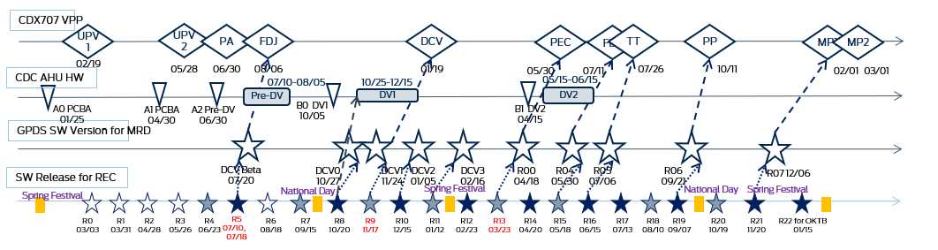
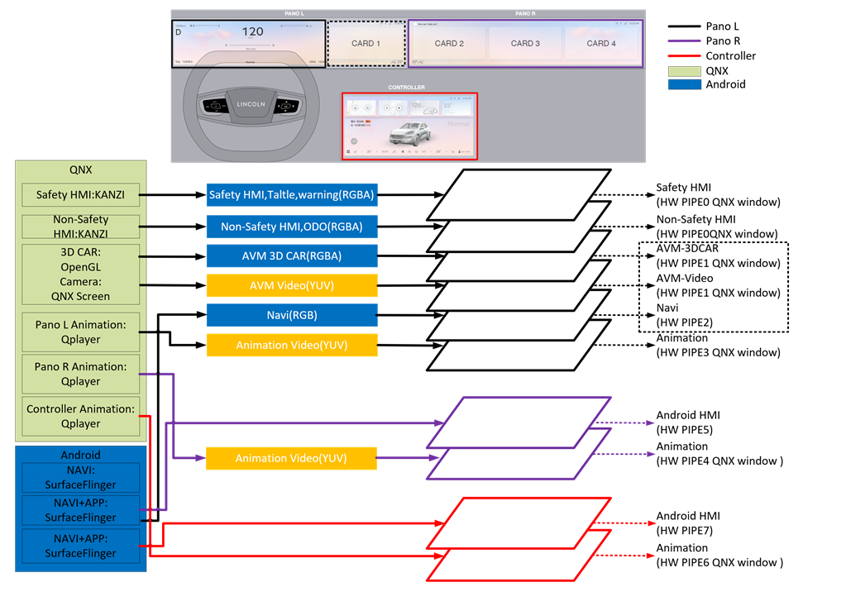
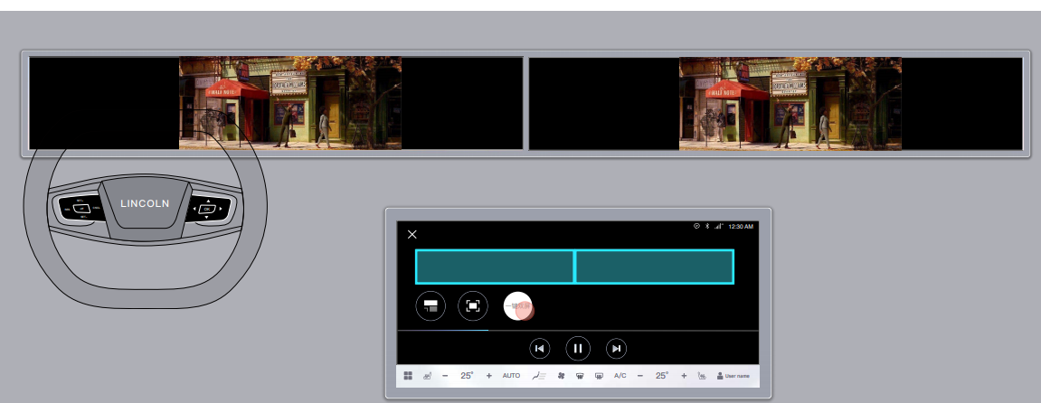
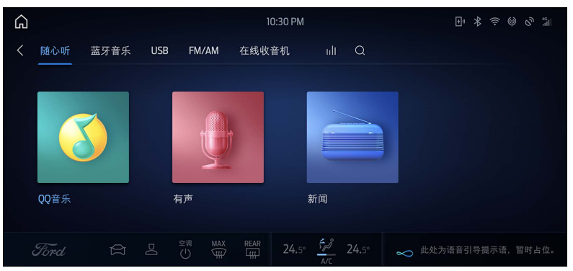
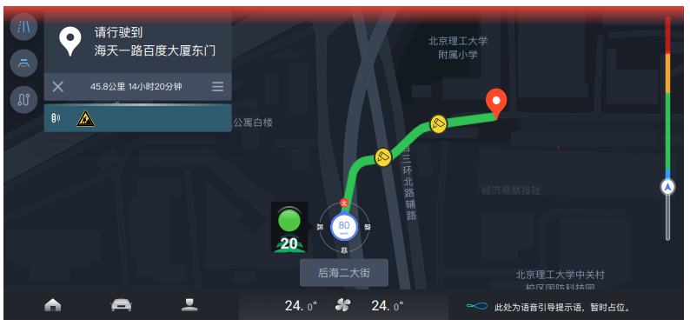
Background Introduction
Timing Plan
HW/SW Timing
UE->Hero Screen->UI
Pipe Line -Coding
Hero Screen and UI
UE
PIPELINE

Slide 13
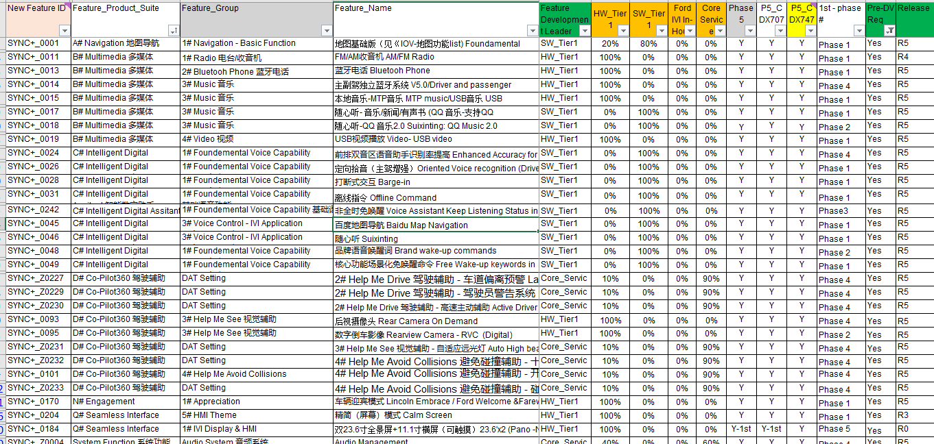
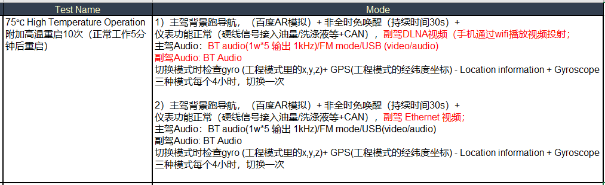
Pre-DV/EMC Validation Mode and FIP
EMC Mode
Pre-EMC: Audio/Camera/BT/Ethernet
Pre-DV: Nav/Audio/Media/VR/BT/Bezel Diag/DLNA
FIP
DV Mode

Slide 14
CDX707 SW Release Plan—HMI Risk
2021 | 2022 | 2023
1 | 2 | 3 | 4 | 5 | 6 | 7 | 8 | 9 | 10 | 11 | 12 | 1 | 2 | 3 | 4 | 5 | 6 | 7 | 8 | 9 | 10 | 11 | 12 | 1 | 2 | 3 | 4 | 5 | 6 | 7 | 8 | 9 | 10 | 11 | 12
CDX707 VPP
UPV2
UPV1
PA
FDJ
DCV
PEC
FEC
TT
PP
MP1
MP2
OKTB
02/19
05/28
06/11
06/30
07/14
08/06
08/20
02/02
05/30
06/13
07/11
07/25
07/26
08/02
10/11
10/18
03/28
03/01
CDC AHU HW
02/01
07/10-08/05
10/25-12/15
05/15-06/15
Pre-DV
B0 DV1
10/05
DV1
DV2
A0 PCBA
01/25
A1 PCBA
04/30
A2 Pre-DV
06/30
B1 DV2
04/15
Display(23.6+23.6,11.1 touch)
09/30-10/30
12/05-12/11
23.6 Pre-DV
03/22-06/09
11.1 EMC
23.6 DV
GPDS SW Version for MRD
DCV Beta
07/20
DCV2
01/05
R04
05/30
SW Release for REC
DCV0
10/27
DCV1
11/24
DCV3
02/16
R00
04/18
R05
07/06
R06
09/21
R07 12/06
Spring Festival
National Day
Spring Festival
National Day
Spring Festival
R15
05/18
R16
06/15
R17
07/13
R19
09/07
R20
10/19
R21
11/20
R22 for OKTB
01/15
R1
03/31
R4
06/23
R5
07/10，07/18
R10
12/15
R11
01/12
R12
02/23
R13
03/23
R14
04/20
R18
08/10
R0
03/03
R2
04/28
R3
05/26
R6
08/18
R7
09/15
R8
10/20
R9
11/17
Package 1-3-HW+Base SW
R15
04/20
R20
09/07
R21
10/19
R22 for OKTB
12/15
CAN’T MEET Pre DV/DCV/PEC Requirement.
J1 deferral.
R0
02/23
R1
03/03
R2
03/31
R3
04/28
R4
05/26
R5
06/20
R6
07/21
R7
08/18
R8
09/15
R9
10/20
R10
11/17
R11
12/15
R12
01/12
R13
02/23
R14
03/23
R16
05/18
R17
06/15
R18
07/13
R19
08/10
Issue3:
UI release plan has been delayed by 4.5 months and not frozen yet. Unsigned Group A&B UI should be released in advance supporting SW release.
IVI UI Plan- Jan.15 Update
Group B
02/15
Group A
05/05
Group C 07/30->09/01(TBC)
Group D
08/31->10/15(TBC)
Issue2:
IVI signed-off UE release plan has been delayed by 3 months; HMI should release unsigned UE supporting SW coding (refer to aligned plan in Slide8),
Group A
12/15
Group B
06/15->07/15(TBC)
IVI UE Plan- Jan.15 Update
Group A
12/15
Group B
02/15
Group A
03/15
Group B
04/30
Group C
05/31
Group D
06/15
Issue1:
Cluster UX will be released by UPV2，Details including Animation concept/multi theme will be continued to refine, Risk under control.
Pro version released for REC, focus and lite test.
Cluster UI Plan- Unclear
Pro version released for REC, full test.
Group A&B& UE
03/05
Group C
04/12
Group D
06/11

Slide 15
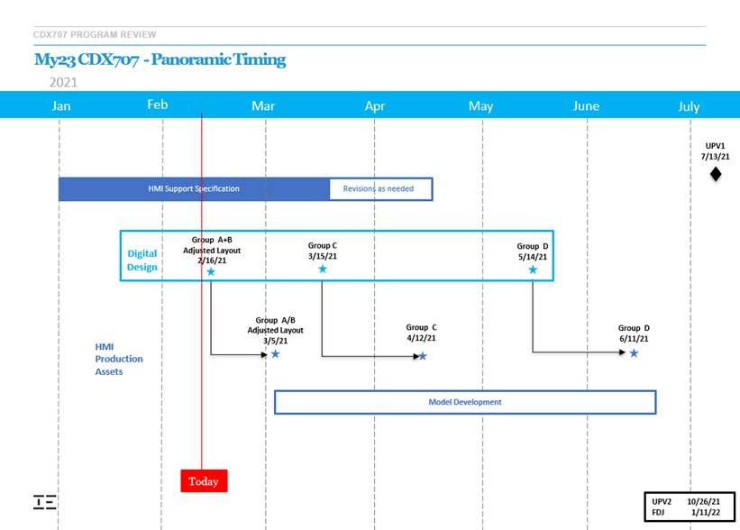
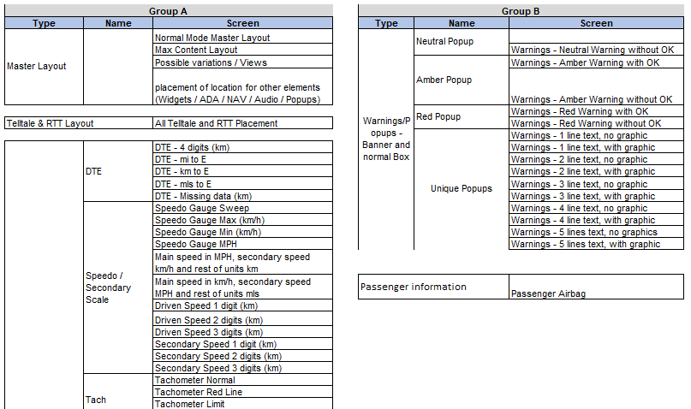
CDX707 Cluster HMI Release Plan
Cluster Grouping Docs will be continued to refine, Risk under control.

Slide 16
CDX707 Minimum IVI Group A Delivery
What can we do now to meet CDX707 J1?
Launcher& System UI
Climate
Camera
(4) Radio
(5) Bluetooth/USB Music
(6) Video
(7) System setting
(8) Navi (SW_Tier1 Release UX)
(9) Fundamental voice function (SW_Tier1 Release UX)
(10) DLNA
(11) Bluetooth Phone
IVI SW vendors have increased headcount to compensate the delay caused by HMI, but still has risk.
ICA: Breakdown the UX release plan feature by feature. Need HMI team support deliver draft or preliminary UX for coding.

Slide 17
CDX707 Minimum IVI Group A Delivery---J1 deferral 6 weeks
Features | Feature Owner | HMI Lead | Function Clarification | UE Delivery (<1Week) | UE Sign-off (1 Week) | Hero Screen (1 month??) | UI Delivery (2 Weeks Ergo Signoff + 2 Weeks HMI Delivery) | UI Stagger Requested by EESE | Gap/Weeks | UI Sign-off (2 weeks) | Comments
(1) System UI | TBD | Zhang Yiwan | Feb.8 | Feb.9 | Feb.9 | Mar. 30->Mar. 15 | Apr. 28 -> Apr. 13 | Mar. 1 | 6 | May 13 -> Apr. 22 | UI Apr.1 deliver without Ergo sign off
(1) Launcher | TBD | Zhang Yiwan | Feb.20 | Feb. 23 | Feb.25 | Mar. 30->Mar. 15 | Apr. 28 -> Apr. 13 | Mar. 1 | 6 | May 13 -> Apr. 22 | UI Apr.1 deliver without Ergo sign off
(2) Climate | Xie Will | Pan Jingjing | Jan.29 -> Feb. 3 | Feb.20 -> Feb. 23 | Feb. 26 | Mar. 30->Mar. 15 | Apr. 28 -> Apr. 14 | Mar. 19 | 4 | May 13 -> Apr. 29
(3) Camera – 360,RVC | Li Xin | Zou Yujuan | Feb.8 -> Feb. 22 | Mar.8 -> Feb.24 | Mar.15 -> Mar.5 | Mar. 30->Mar. 15 | May 5 -> Apr. 21 | Apr. 6 | 4 | May 19 -> May 5 | Feasibility under YFVE confirm
(4) Radio - AM/FM | Xiang, Zhengxi | Wang, Wei Hua | Feb.8 | Mar.8 -> Feb. 23 | Mar.15 -> Mar.1 | Mar. 30->Mar. 15 | May 5 -> Apr. 21 | Apr.6 | 4 | May 19 -> May 5
(5) Bluetooth Music | Xu Amy | Chen Yu | Jan.29 | Feb. 9 | Feb.26 | Mar. 30->Mar. 15 | Apr. 28 -> Apr. 14 | Mar. 19 | 4 | May 13 -> Apr. 29
(6) USB Video | Xiang, Zhengxi | Luisa Liu | Feb. 8 | Mar.8 -> Feb. 23 | Mar.15 -> Mar.1 | Mar. 30->Mar. 15 | May 5 -> Apr. 21 | Apr.6 | 2 | May 19 -> May 5
(7) System Setting Details in next slide | In next slide | In next slide | Feb.8 | Mar.8 | Mar.15 | Mar. 30->Mar. 15 | May 5 -> Apr. 21 | Mar. 19 | 5 | May 19 -> May 5
(8) DLNA | Jia, Elaine | Wang, Wei Hua | Feb.8 -> Feb.20 | Mar.8->Mar.3 | Mar.15 | Mar. 30->Mar. 15 | May 5 -> Apr. 14 | Apr.15 | 0 | Apr.30 -> Apr. 29
（9）Bluetooth Phone | Xu Amy | Chen Yu | Jan.29 | Feb.20 -> Feb.8 | Feb.26 | Mar. 30->Mar. 15 | Apr. 28 -> Apr. 14 | Mar. 19 | 4 | May 13 -> Apr. 29
(10) USB Music | Xiang, Zhengxi | Wang, Wei Hua | Jan.29 | Feb.9 | Feb.26 | Mar. 30->Mar. 15 | Apr. 28 -> Apr. 14 | Mar. 19 | 4 | May 13 -> Apr. 29
1. Hero Screen 03/15 delivery should be promised and optimized.
2. UI Delivery time should be optimized based on feature complexity.

Slide 18
CDX707 Minimum IVI Group A Delivery---J1 deferral 6 weeks
 | Features | Feature Owner | HMI Lead | Function Clarification | UE Delivery (<1Week) | UE Sign-off (1 Week) | Hero Screen (1 month??) | UI Delivery (2 Weeks Ergo Signoff + 2 Weeks HMI Delivery) | UI Sign-off (2 weeks)
System Setting | 一级菜单 1st level menu | Huang, Xue |  | Feb. 8 | Feb. 22->Feb.23 | Feb. 25 | Mar.30->Mar.15 | May. 5->Apr.21 | May 19->May.5
 | 语音设置 audio setting | Huang, Xue | Pan, Jingjing | Feb.8 -> TBD | Mar.8->TBD | Mar.15 | Mar.30->Mar.15 | May 5->Apr.21 | May 19->May.5
 | 蓝牙连接 BT connection |  | Chen, Yu | Feb.8 | Mar.8 -> Feb. 9 | Mar.15 | Mar.30->Mar.15 | May 5->Apr.21 | May 19->May.5
 | 日期和时间设置 date&time setting |  | Wang, Wei Hua | Feb.8 | Mar.8 | Mar.15 | Mar.30->Mar.15 | May 5->Apr.21 | May 19->May.5
 | Brightness |  | Wang, Wei Hua | Feb.8 | Mar.8 | Mar.15 | Mar.30->Mar.15 | May 5->Apr.21 | May 19->May.5
 | Display off |  | Wang, Wei Hua | Feb.8 | Mar.8 | Mar.15 | Mar.30->Mar.15 | May 5->Apr.21 | May 19->May.5
 | 显示/亮度设置 display/brightness setting | Chen, James | Wang, Wei Hua | Feb.8 | Mar.8->Feb.23 | Mar.15 | Mar.30->Mar.15 | May 5->Apr.21 | May 19->May.5
 | 关于本机 | Huang, Xue | Zou, Yujuan | Feb.8 | Mar.8->Feb.23 | Mar.15 | Mar.30->Mar.15 | May 5->Apr.21 | May 19->May.5
 | 声音设置 sound setting |  | Wang, Wei Hua | Feb.8 | Mar.8->Feb.23 | Mar.15 | Mar.30->Mar.15 | May 5->Apr.21 | May 19->May.5
 | Wifi 热点 Wifi Hot Spot |  | Wang, Wei Hua | Feb.8 | Mar.8->Feb.23 | Mar.15 | Mar.30->Mar.15 | May 5->Apr.21 | May 19->May.5
 | wifi设置 wifi setting |  | Wang, Wei Hua | Feb.8 | Mar.8->Feb.23 | Mar.15 | Mar.30->Mar.15 | May 5->Apr.21 | May 19->May.5
 | Keyboard | Yao, Tristan | Liu, Luisa (Fan.) | Feb. 8 | Mar. 15->Feb.24 | Mar. 30-> Feb.26 | Mar.30->Mar.15 | Apr.5 | Apr.20

Slide 19
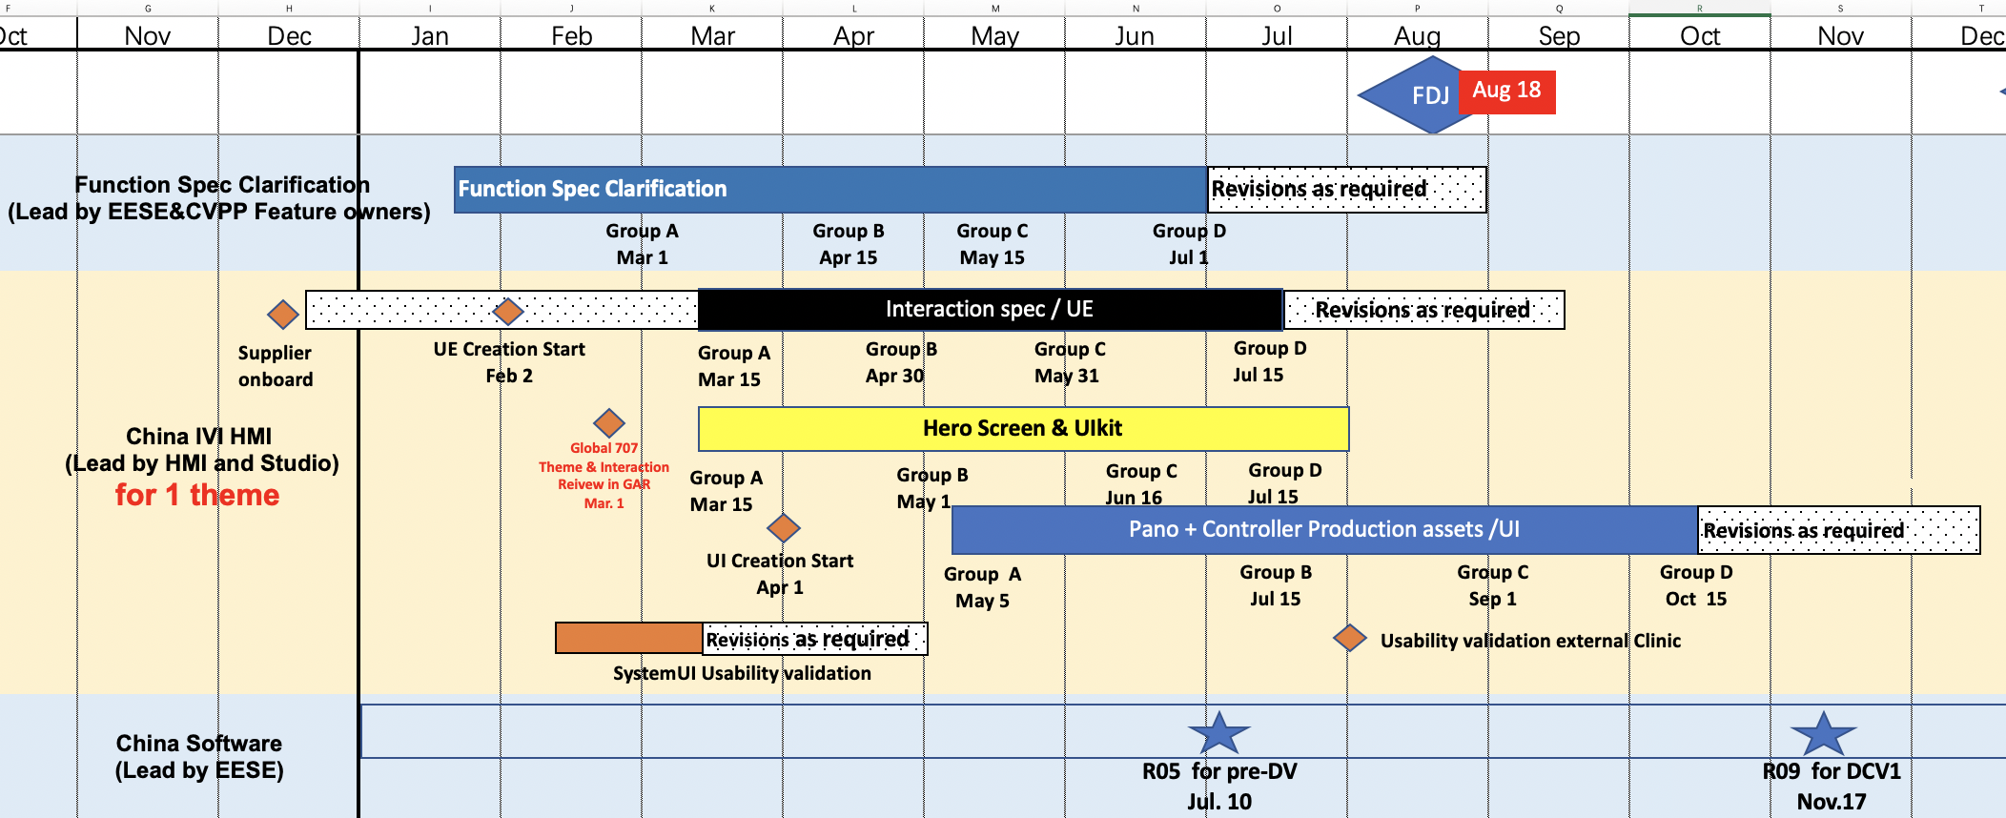
CDX707 IVI Group B-D UI <Timing update Feb25> Should be Updated
Should be updated and pulled ahead.

Slide 20
The Potential Risk of CDX707
Hardware Risk: Hardware design & validation not completed by DCV MRD/DCV if Pre-DV/DV software release delay 1.5 months.
Critical DV can not be completed by DCV MRD.
Risk of module with faulty functions to support DCV build.
Vehicle DV(EMC/thermal/audio attribute..etc) sign-off can not catch-up PEC/FEC milestone.
Component re-DV sign-off can not catch-up FEC milestone.
HMI Risk: Un-signed HMI UE and UI delivered to supplier for development and software integration. Low quality of software performance, interaction, experience can’t support plant launch/validation process(FCPA/R202/VOCF/Management evaluation etc.), Especially AIMS flow(Software team doesn't accept AIMS in for this level software w/ un-signed HMI UX). AIMS should not be reported until PEC.
SW stability: The HMI unsigned UE & UI delivers 3 suppliers for software development and integration in stagger way, this definitely would cause pretty much more frequent software integration/release/validation. This could cause high software delivery risk/cost(for example, regression bug, unexpected issue during re-release software, capability and stability issue).
Deviation for PEC/FEC should be needed: the PEC/FEC for IVI SW need to be postponed or the reduce the criteria .
People resource/Support should be added: More NSPS testing service/Test vehicle(5 vehicles) required to catch up the frequent software release and validation, and cover more issue reported from JV plant. Need program to coordinate and organize the enhanced test plan in plant(5 vehicles*10 tester*5days).

Slide 21
CDX707 SW Release Plan---IVI HMI Plans
2021 | 2022 | 2023
1 | 2 | 3 | 4 | 5 | 6 | 7 | 8 | 9 | 10 | 11 | 12 | 1 | 2 | 3 | 4 | 5 | 6 | 7 | 8 | 9 | 10 | 11 | 12 | 1 | 2 | 3 | 4 | 5 | 6 | 7 | 8 | 9 | 10 | 11 | 12
CDX707 VPP
UPV2
PA
FDJ
DCV
PEC
FEC
TT
PP
MP1
MP2
UPV1
02/19
05/28
06/30
08/06
01/19
05/30
07/11
07/26
10/11
02/01
03/01
GPDS SW Version for MRD
DCV Beta
07/20
DCV2
01/05
R04
05/30
DCV1
11/24
R00
04/18
R05
07/06
R06
09/21
DCV0
10/27
DCV3
02/16
R07 12/06
#1:CDC AHU HW
07/10-08/05
10/25-12/15
05/15-06/15
[HMI Plan Delivery Agreement@2020/11/25]: HMI release plan can meet SW release requirements.
UE: Group A-Dec 15, Group B-Feb 15
UI: Group A-Dec 15, Group B-Feb 15
A0 PCBA 01/25
A1 PCBA 04/30
A2 Pre-DV 06/30
Pre-DV
DV1
B1 DV2 04/15
DV2
#1:SW Release for REC
B0 DV1 10/05
R5 07/10,07/18
R8 10/20
R9 11/17
R13 03/23
#2: CDC AHU HW
09/30-10/31
01/05-03/05
07/15-08/15
[HMI Plan@2021/1/17]: The overall SW delay is about 2.5 months, Pre-DV and DV1(DCV) delay 2.5 months, J1 delay 2 months
UE: Group A-Mar 15, Group B-Apr 30
UI: Group A-Apr 30, Group B-Jun 15
Pre-DV
DV1
DV2
#2: SW Release for REC
J1 deferral 2 months
R5 09/24
R8 12/31
R9 1/29
R13 05/23
#3：CDC AHU HW
11/15-12/10
02/25-04/15
08/15-09/15
[HMI Plan@2021/02/01 Draft ]:The overall delay is about 4 months, Pre-DV and DV1(DCV) delay 4 months, J1 delay 3 months
UE: Group A-Mar 15, Group B-Apr 30
UI: Group A-Jun 15, Group B-Jul 30
Pre-DV
DV1
DV2
#3： SW Release for REC
J1 deferral 3 months
R5 11/10
R8 02/21
R9 03/17
R13 06/23
#4：CDC AHU HW
08/15-09/15
11/25-01/15
06/15-07/15
[Engineering proposal @ 2021/02/24]: Minimize HMI delivery of features one by one to provide UE and UI supporting SW release. The overall SW delay is about 1.5 month, Pre-DV and DV1(DCV) delay 1.5 month, J1 delay 1.5 month
UE: Group A-Mar 15, Group B-Apr 20(TBC)
UI: Group A-May 5, Group B-May 20(TBC)
Pre-DV
DV1
DV2
#4： SW Release for REC
J1 deferral 1 month
R5 08/10
R8 11/19
R9 12/17
R13 04/22

Slide 22
HMI Enablers to Support Software Release Plan
Enablers (including Driver info, Pano, Controller) | Lead | Target Date
(1) UE Stagger Group A (2) Framework to be frozen (3) UE and Logic Flow Final Group A common features (4) UE and Logic Flow Final Group A China unique features | M Schneider M Schneider & Julia M Schneider Julia Zhu | On-going Feb 18 Feb 25 Mar 15
(5) Hero Screen Stagger Group A (6) Hero Screen Final Group A | P Ruthenberg P Ruthenberg | On-going Mar 1
(7) UI Stagger Group A (8) All Assets & Slicing Final Group A common feature (9) All Assets & Slicing Final Group A China unique features | M Schneider M Schneider Julia Zhu | On-going Mar 27 Apr 27
The Enablers above supports a Recovery to a 1 Month CDX707C J1 deferral 3 Months
Further enablers required to recover J1 Timing per Plan of Record; Feb 2023

Slide 23
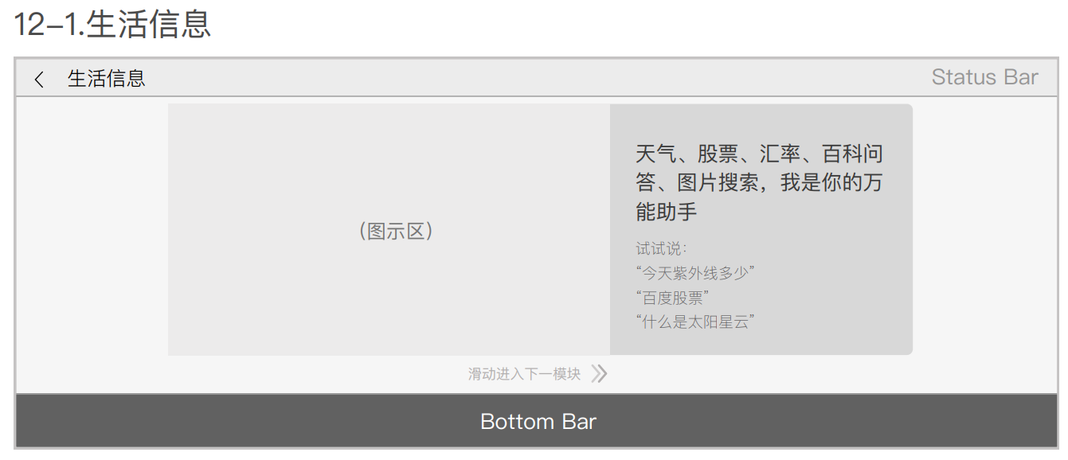
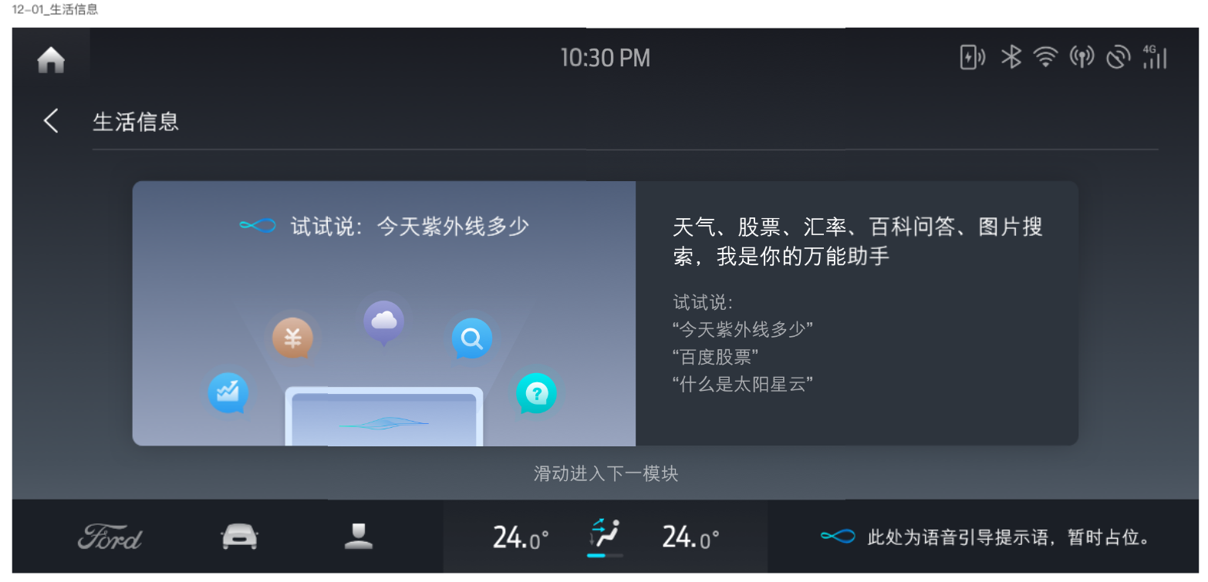
UE-Hero Screen-UI Introduction
UE: User Experience
Focus on user interaction, the jump logic between the different interfaces or buttons. But no detailed coordinates or size information.
Hero Screen
Part of the UI design pages, If a product has a total of 8000 UI pictures, HMI team will design the main 200 pictures as hero screen for reference, and than design the other pictures.
UE: User Experience
UI: User Interface
Focus on visual design, responsible for product graphics, icons, color matching, creating beauty, style and temperament.
UI: User Interface
UI: User Interface

